Slide 1
CAN PROTOCOL BASED Automated RAIN WIPER CONTROL AND TOXIC GAS DETECTION
BY
DEEPAK SRINIVAAS.S
PUGAZHENTHY.A
VISHNU NAGARAJ.B

Slide 2
EXISTING METHODS
Manually Controlled Wipers
No dedicated speed control
Requires unnecessary work during driving
No precautions when toxic gas is encountered
DRAWBACKS
Presence of toxic gas is fatal
Wipers not automated
Totally time consuming
Risk driving during Rain

Slide 3
PROPOSED METHOD
Automated wiper functioning
Communication based on CAN protocol
Rain sensor to detect rainfall
Force sensor to measure rain intensity
Automated wiper speed control
Gas sensor to detect toxic gas
PIR sensor to detect the presence of humans
Automated door glass opening

Slide 4
COMPONENTS USED
ARM TM4C123GXL PROCESSOR
RAIN SENSOR
FORCE SENSOR
GAS SENSOR
PIR SENSOR
WIPER MOTOR AND DOOR MOTOR
12V POWER SUPPLY

Slide 5
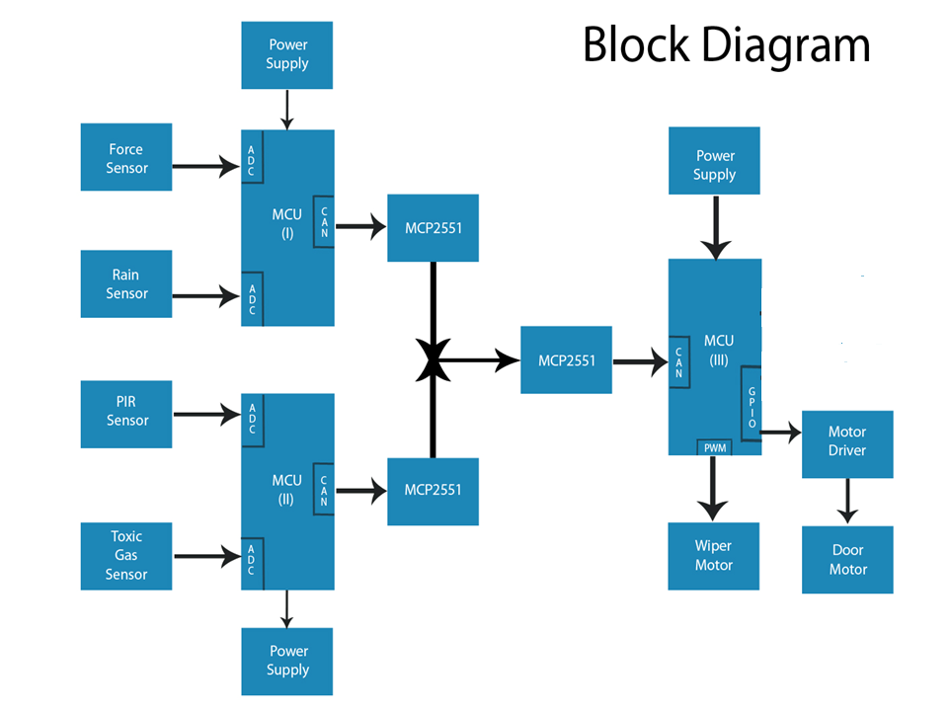

Slide 6
Controller Area Network
CAN bus is a vehicle bus standard designed to allow microcontroller and devices to communicate with each other in vehicle.
It is a message based protocol.
It is present in both physical and data link layer of OSI layers.
It is a multi-master serial bus .

Slide 7
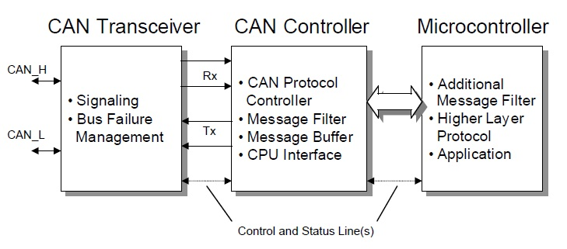
Stand alone CAN Controller

Slide 8
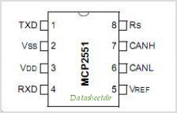
CAN Transceiver

Slide 9
Message Frame
Start of Frame.
Arbitration Field.
Identification Field.
Data Field.
CRC Field.
Acknowledgement bits.
End of Frame.

Slide 10
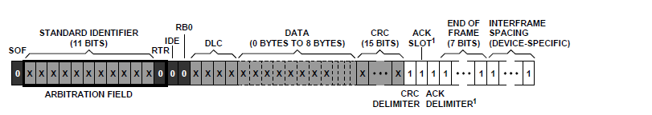
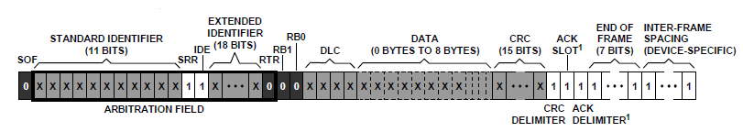
Message Frame Structure
Standard Data Frame
Extended Data Frame

Slide 11
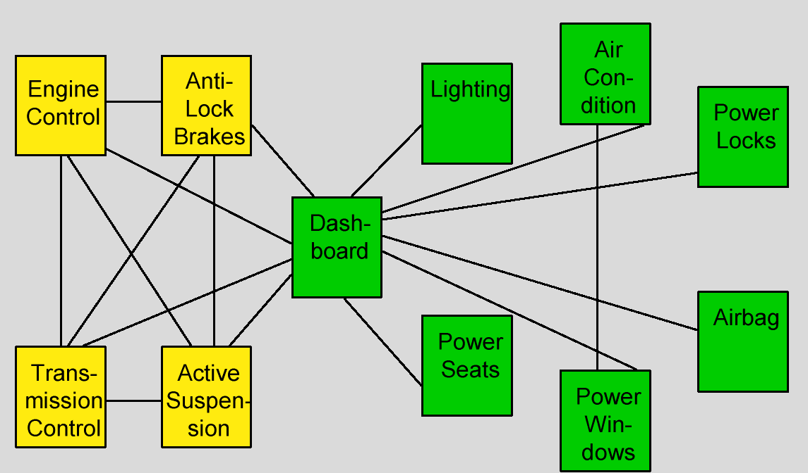
Before CAN

Slide 12
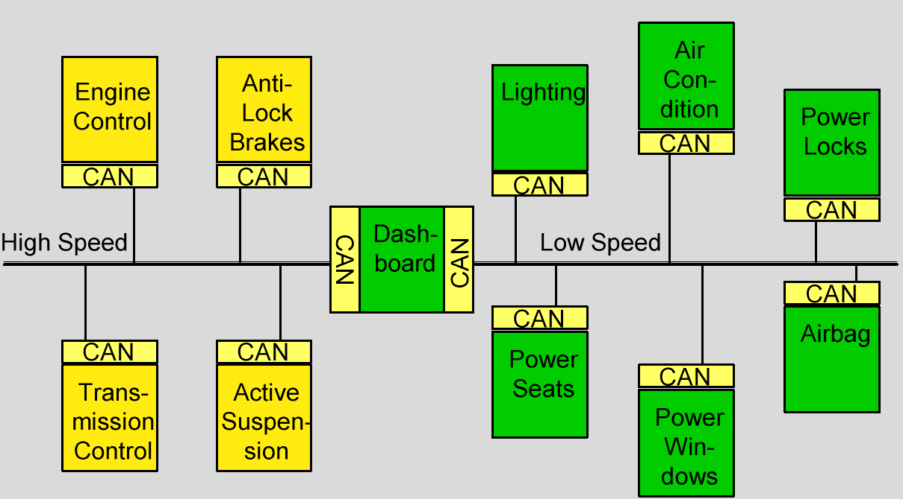
After CAN

Slide 13
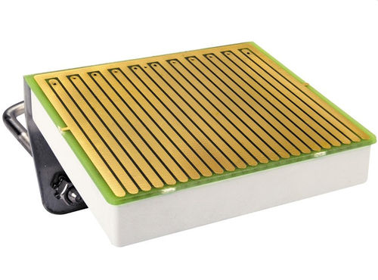
RAIN SENSORS
A rain sensor or rain switch is a switching device activated by rainfall. In case of rain the water drop establishes an electrical contact between the two electrodes of the sensor surface, and releases immediately a current signal.
Voltage: 5V
The raindrop detection plate large area : 5.4 * 4.0 MM

Slide 14
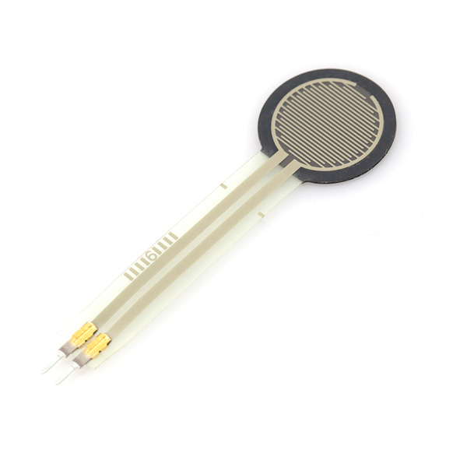
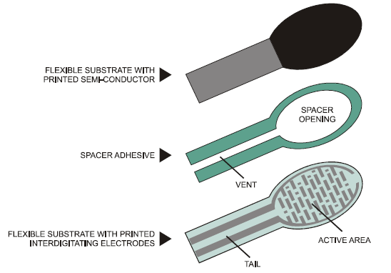
FORCE SENSOR
Force Sensing Resistors (FSR) are a
polymer thick film (PTF) device which
exhibits a decrease in resistance with an
increase in the force applied to the
active surface. Its force sensitivity is
optimized for use in water force pressure
control of electronic devices.

Slide 15
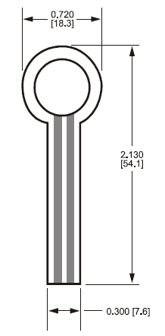
SPECIFICATIONS
Active Area: 0.5” [12.7] diameter
Nominal thickness: 0.018” [0.46 mm]
Material Build:
Semiconductive Layer
0.005” [0.13] Ultem
Spacer Adhesive
0.006” [0.15] Acrylic
Conductive Layer
0.005” [0.13] Ultem
Rear Adhesive
0.002” [0.05] Acrylic
Force Sensitivity Range < 100 g to > 10 kg
Pressure Sensitivity Range < 1.5 psi to > 150 psi
(< 0.1 kg/cm2 to > 10 kg/cm2)
Stand-Off Resistance > 1MΩ
Device Rise Time 1-2 msec (mechanical)
Lifetime > 10 million actuations
Temperature Range -30ºC to +70°C
Maximum Current I mA/cm2 of applied force

Slide 16
Functions of Auto Wipe
The rain-sensitive wiper function detects the rain droplets on vehicle windscreen and also detects the force of the droplets from the force sensor and activates the front wipers to operate intermittently, low or high speed mode according to the force on the sensor.
This function frees driver from adjusting wipers manually in intermittent rain condition.

Slide 17
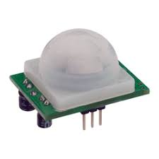
PIR (Passive Infra-Red) Sensor
The PIR (Passive Infra-Red) Sensor is a pyroelectric device that detects motion by measuring changes in the infrared levels emitted by surrounding objects. This motion can be detected by checking for a high signal on a single I/O pin.
The product features include:
• Single bit output
• Small size makes it easy to conceal
• Compatible with all types of microcontrollers
• 5V till 20V operation with <100uA current draw
Operating power supply +4.5V - +5.5V
Operating Temperature -15°C - +70°C

Slide 18
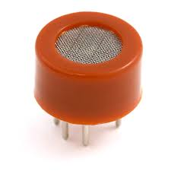
GAS SENSOR (MQ 2)
This Insight covers a gas sensor that can sense gases such as Carbon monoxide, LPG, methane, propane, alcohol and smoke which might get produced. When a gas interacts with this sensor, it is first ionized into its constituents and is then adsorbed by the sensing element. This adsorption creates a potential difference on the element which is conveyed to the processor unit through output pins in form of current.
Circuit voltage - 5V±0.1
Heating voltage - 5V±0.1
Heater resistance - 33Ω
Heating consumption - less than 800mw
Detecting concentration scope：
200ppm-5000ppm LPG and propane
300ppm-5000ppm CO
5000ppm-20000ppm methane
300ppm-5000ppm smoke
100ppm-2000ppm Alcohol

Slide 19
Functions of Gas Detection
The gas sensors detect the presence of toxic gas inside the car when the door window glasses are closed. After a confirmation on the presence of humans by the PIR sensor, the door window glass is opened by the door glass motor.

Slide 20
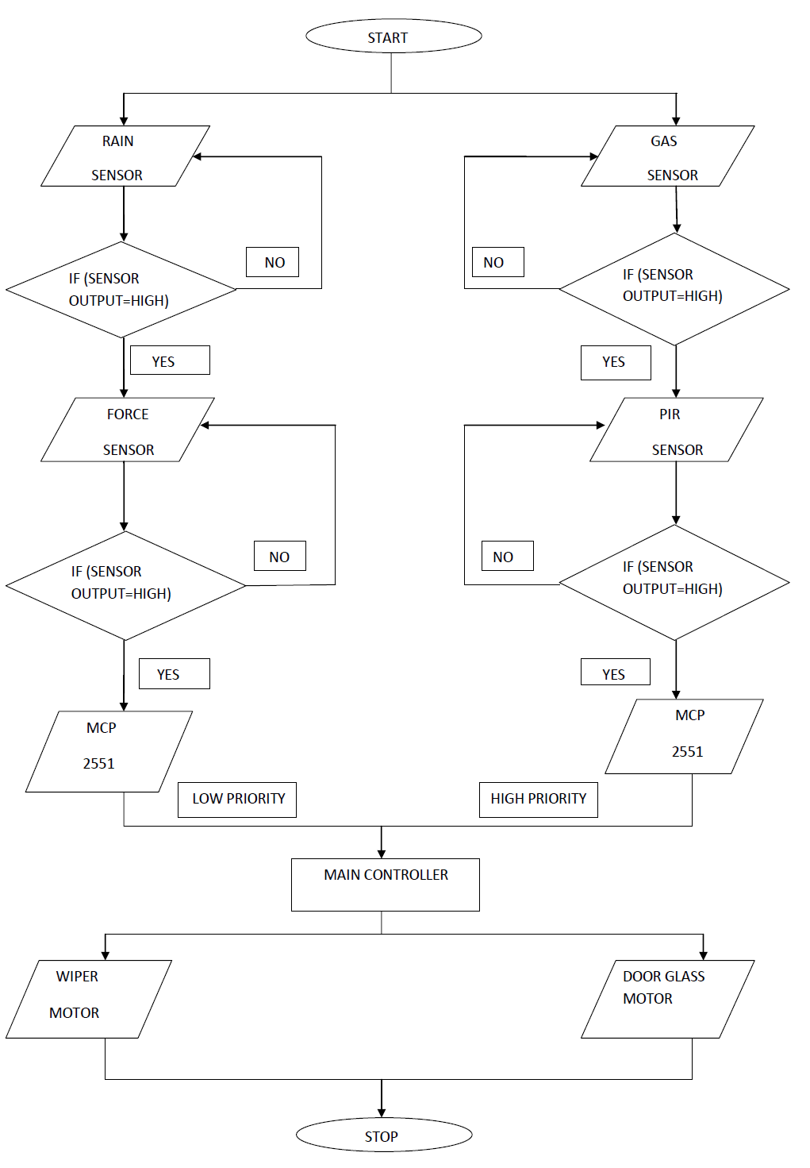
FLOWCHART

Slide 21
CONCLUSION:
We have developed an automatic wiper control system which is improved version of intermittent wiper system.
This wiper system reduce cumbersome wiper operation and improve driver’s level comfort. It will give a new dimension of comfort and aid to the drivers who work at night and traffic prone areas where they already have to concentrate on brakes and clutch. The removal of controlling the wipers during rain will provide them much ease and help them concentrate on the basic ABC (accelerator, brake and clutch) of driving.
Our system features high accuracy, high sensitivity, and non-contact measurement.
The system are used as component in home automation system because it can detect a sudden rain and notify people in the house.

